Slide 1

EMOTIONAL SUPPORT AI APPLICATION
✨ Realized by Houssam LAQSIR, Aymane MAIZI, Mohamed SANBI, Kodjo Robert EZIAN ✨

Slide 2


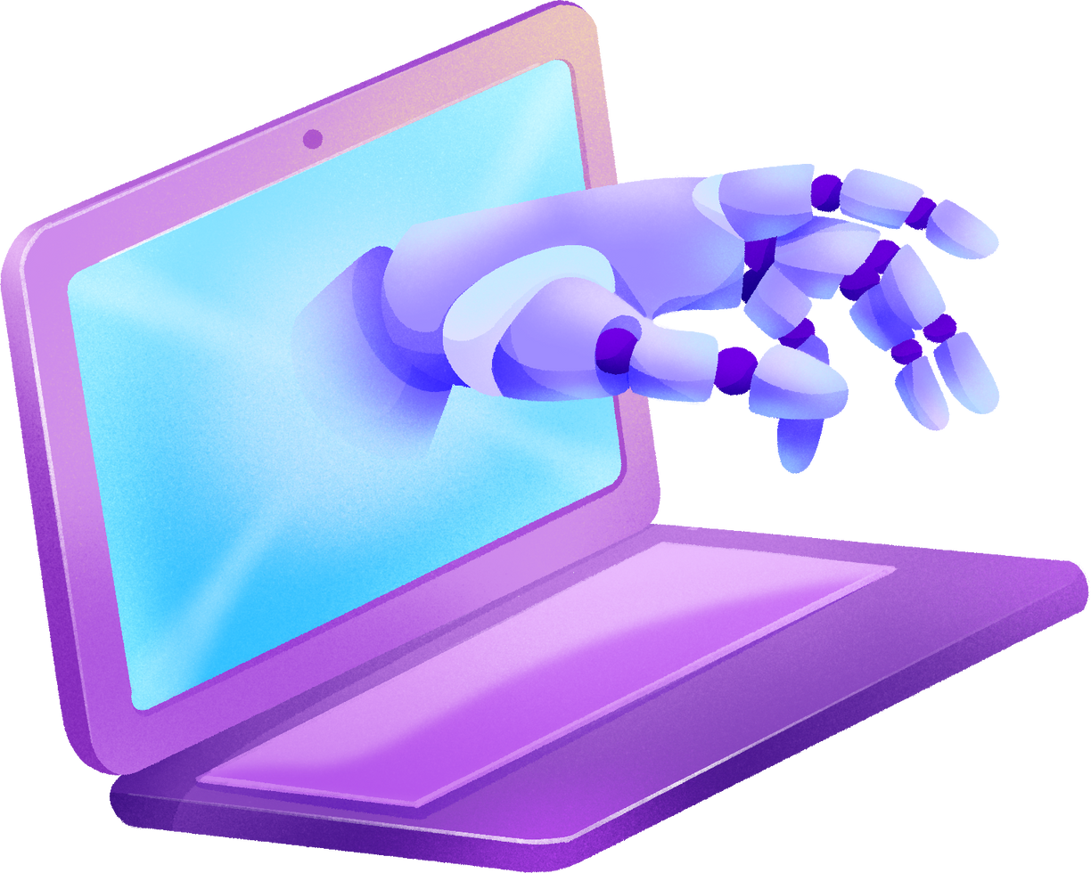

Introduction
Many individuals face challenges in finding accessible, personalized, and empathetic emotional support tools. This project addresses these gaps by creating an AI-driven application that provides users with emotional support, combining advanced technologies to ensure an intuitive and accessible experience.

Slide 3






Application Architecture and tools:
Query
Flask
GUI
Backend
APIs for LLM
React

Slide 4

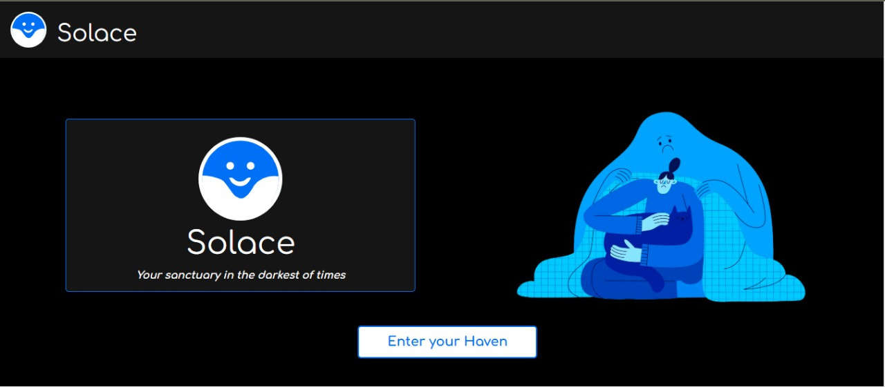
Welcome Page
The welcoming interface provides a comforting entry point for users, emphasizing safety and support.

Slide 5
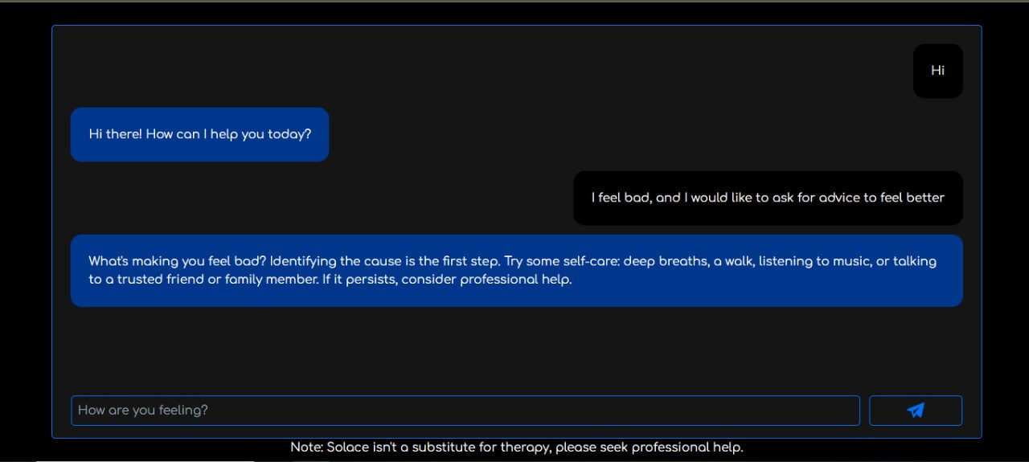
Chat Interface:
The real-time chat interface enables users to share their emotions and receive empathetic responses in a simple and intuitive design.

Slide 6


Conclusion
This project demonstrates the potential of AI in providing personalized emotional support through advanced technologies. Future work will focus on enhancing the knowledge base and refining AI models to ensure more effective and empathetic interactions with users.

Slide 7

Thank You
For Your Attention!

